Slide 1


2013 PRIM Investor Conference
Bentley University
May 9, 2013
Steven Grossman, Treasurer and Receiver General, Chair
Michael G. Trotsky, CFA, Executive Director and Chief Investment Officer

Slide 2
Opening Ceremonies/Welcome
Paul W. Todisco
Senior Client Service Officer
Steven Grossman, Treasurer and Receiver General, Chair
Michael G. Trotsky, CFA, Executive Director and Chief Investment Officer

Slide 3
Chair’s Welcome
Steven Grossman
Commonwealth of Massachusetts
Treasurer and Receiver General
PRIM Board Chair
Steven Grossman, Treasurer and Receiver General, Chair
Michael G. Trotsky, CFA, Executive Director and Chief Investment Officer

Slide 4
Executive Director’s Welcome
Michael G. Trotsky, CFA
Executive Director
Chief Investment Officer
Steven Grossman, Treasurer and Receiver General, Chair
Michael G. Trotsky, CFA, Executive Director and Chief Investment Officer

Slide 5
Organization
Performance
Asset Allocation
Organization Goals

Slide 6

Organizational Chart
Executive Director
Chief Investment Officer
Michael G. Trotsky, CFA August 18, 2010
Senior Investment Officer
Real Estate and Timberland
Timothy V. Schlitzer March 21, 2005
Investment Officer
Real Estate and Timberland
John F. LaCara
August 4, 2008
Senior Investment Officer
Director of Private Equity
Michael R. Bailey
February 26, 2013
Senior Investment Officer
Private Equity
Scott L. Hutchins
January 4, 2010
Investment Officer
Private Equity
OPEN
Deputy Chief Investment Officer
Public Markets and
Director of Strategic Initiatives
Hannah Gilligan Commoss August 2, 2004
Senior Investment Officer
Public Markets
Sarah N. Samuels, CFA
June 27, 2011
Deputy Executive Director
General Counsel
Christopher J. Supple
July 26, 2011
Chief Operating Officer
Chief Financial Officer
Thomas A. Hanna, CPA
May 22, 2000
Director of Finance
and Manager of Human Resources
Deborah Coulter, CPA
August 1, 2012
Manager of Investment Reporting and Systems Administrator Yisroel "Izzy" Markov, CPA
February 16, 1998
Manager of Client Reporting and Cash Management
Jennifer L. Cole
February 11, 2002
Senior Financial Analyst
Eileen A. Molloy July 22, 2002
Senior Financial Analyst
Catherine M. Hodges March 8, 2004
Financial Analyst
Veronica Williams
January 9, 2006
Chief Technology Officer
Anthony J. Falzone
January 3, 2006
Financial
Reporting Manager
Qingmei Li, CPA
August 18, 2011
Investment Officer
Private Equity
Peony K. Keve, CFA, CAIA
July 21, 2008
Executive Assistant
Samantha Wong
October 4, 2010
Office Administrator
Alyssa Smith
February 17, 2004
Investment Analyst
Public Markets
Michael Carritte
October 13, 2011
Accounting Assistant
Nicole E. Gruet
February 1, 2013
Senior Investment Officer
Hedge Funds and
Low Volatility Strategies
Eric R. Nierenberg, Ph.D.
December 5, 2012
Compliance Analyst
Ellen M. Hennessy
April 30, 2012
Investment Officer
Pubic Markets
OPEN
Accounting Assistant
Morgan D. Burns
April 8, 2013
Receptionist
Nora Mata Davis
April 8, 2013
Deputy Chief Investment Officer
Director of Risk Management
David M. Gurtz, CPA, CFA
January 31, 2008
Senior Client Service Officer
Paul W. Todisco
November 5, 1984
Risk Management Officer
Donald R. Payne
November 6, 2006

Slide 7
Total PRIT Fund Core Performance through March 31, 2013
Notes:
Performance is gross of fees.
Total assets of $53.7 billion as of March 31, 2013.
Since inception (2/28/1985), the total PRIT Core has had an average annual return of 9.58%, as of 3/31/2013.

Slide 8
The PRIT Fund Trailing 1-Year Performance through March 31, 2013
Notes:
Performance is gross of fees, unless otherwise noted.
Total assets of $53.7 billion as of March 31, 2013.
Since inception (2/28/1985), the total PRIT Core has had an average annual return of 9.58%, as of 3/31/2013.

Slide 9
Global Equity Performance Trailing 1-Year Performance through March 31, 2013

Slide 10
Fixed Income Performance Trailing 1-Year through March 31, 2013

Slide 11
PRIT Fund Asset Allocation Long Term Target Allocation – Approved August 2, 2011*

Slide 12
PRIT Core Fund Asset Allocation Targets
 | 2012 | 2013
U.S. Large Cap | 15% | 15%
U.S. Small/Mid Cap | 4% | 4%
International | 17% | 17%
Emerging Markets | 7% | 7%
Total Global Equity | 43% | 43%
Core Bonds | 10% | 10%
TIPS | 3% | 3%
Total Core Fixed Income | 13% | 13%
High Yield/Bank Loans | 3% | 3%
EMD (Dollar Denominated) | 1% | 1%
EMD (Local Currency) | 2% | 2%
Private Debt | 4% | 4%
Total Value Added Fixed Income | 10% | 10%
Private Equity | 10% | 10%
Real Estate | 10% | 10%
Timber | 4% | 4%
Hedge Funds | 10% | 10%
5-7 Year Expected Return* | 7.9% | 7.4%
30 Year Expected Return* | 8.4% | 8.2%
Risk (Std. Deviation) | 12.1% | 12.8%
Sharpe Ratio | 0.55 | 0.52
*Expected Return amended February 5, 2013.

Slide 13
PRIT Fund Asset Allocation Actual Allocation as of March 31, 2013
Global Equity Breakdown
Domestic Equity | 20.3%
International Equity | 17.9%
Emerging Markets Equity | 6.9%

Slide 14
PRIT Fund Ratio of Expenses in Basis Points

Slide 15
2013 Organizational Goals
Project SAVE – To understand, analyze and evaluate the expense structure of PRIM, and recommend the ideal configuration of activities to optimize costs to benefit the plan participants and the taxpayers, while maintaining the PRIT Fund’s overall return and risk characteristics
Manager monitoring – As new CIO I will be spending a significant amount of time getting to know each of our investment managers and their strategies
Transition and guide new senior level investment officers
Complete hiring of three vacant positions

Slide 16
2013 PRIM Investment Plan Highlights
PRIM Staff Panel Discussion
Steven Grossman, Treasurer and Receiver General, Chair
Michael G. Trotsky, CFA, Executive Director and Chief Investment Officer

Slide 17
Public Markets and
Strategic Initiatives
Hannah G. Commoss
Deputy Chief Investment Officer – Public Markets
Director of Strategic Initiatives

Slide 18
Public Markets: PRIT Fund Snapshot
Public Markets accounts for approx. 65% of the PRIT Fund asset allocation (approx. $35 billion) – highlighted in light blue.
38 distinct mandates, across multiple asset classes.

Slide 19
Public Markets: 2012/2013 Accomplishments
Implementation of Asset Allocation Changes
Reallocated $8 billion of Domestic Equity assets
Incepted allocations to Emerging Market Debt – Local Currency and Emerging Market Equity Small Cap
Reintroduced Active Small/SMID Cap Equity
RFPs Completed
Investment Managers
Emerging Market Equity Small Cap
Emerging Market Debt – Local Currency
Small/SMID Cap Domestic Equity
Service Providers
Long-Only Investment Consulting Services
Transition Management Investment Services

Slide 20
Public Markets Current Initiatives
Questions Driving our Initiatives
Do we have appropriate inflation protections in place?
Do we have appropriate interest rate protections in place?
Do our investment managers have the appropriate levels of flexibility?
Do we have best-in-class investment managers across all asset classes?

Slide 21
Public Markets 2013 Initiatives (continued)
Actions Being Taken
Review of Current Asset Classes
Review of the Fixed Income allocation
Review of the Emerging Market Equity allocation
Research
Proactive Management: Increase level of research to identify best-in-class managers in each asset class at all times
Continue to hone new manager screening process for manager procurements
Research investment ideas not currently implemented in the PRIT Fund

Slide 22
Strategic Initiatives

Slide 23
Strategic Initiatives: Enhanced Reporting and Analysis
Deeper incorporation of macroeconomic analysis and impact on the PRIT Fund.
Negative
Moderate
Positive

Slide 24
PRIT Fund Current Strategic Initiatives
Emerging Managers
Identify and source qualified Emerging Manager relationships across asset classes
Complete the outstanding Emerging Manager of Managers RFP
Creation of PRIT Fund “Manager Bench”
Will allow for more nimble and dynamic manager procurement and monitoring
Encourage investment staff, across asset classes, to become familiar with wider set of managers

Slide 25
Risk Management
David M. Gurtz, CPA, CFA
Deputy Chief Investment Officer
Director of Risk Management

Slide 26
2012 Year in Review
The 2012 PRIM key risk management initiatives accomplishments include:
Improved manager searches
Emerging market local currency debt
Emerging market small cap equity
Domestic equity small cap equity
Improved risk discussion with committee, Board and clients
Scenario analysis: Eurozone, China hard landing and fiscal cliff scenarios
Hired Russell to reduce FX trade costs
Assisted in implementation of the direct hedge fund program
Completed MIT Sloan School of Management/PRIM collaboration on risk management of core real estate project

Slide 27
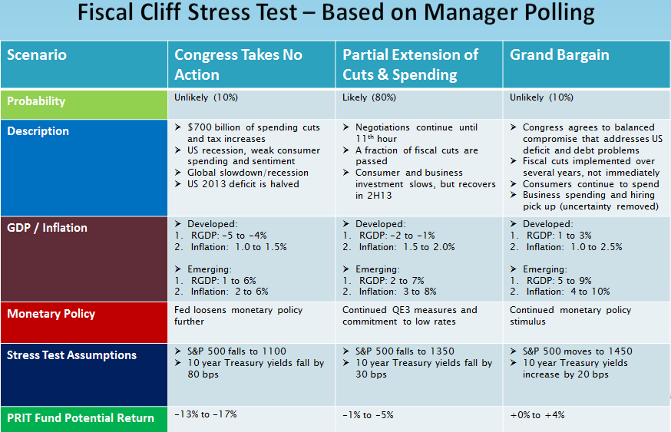

Slide 28
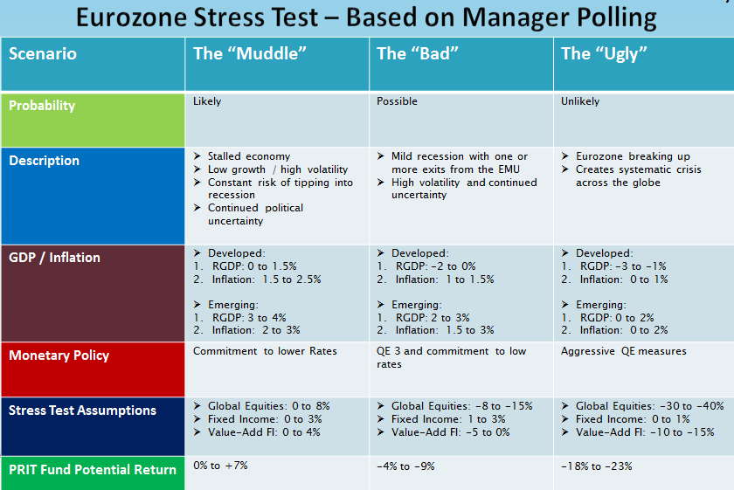

Slide 29
2013 Initiatives
Continue to Use BarraOne to Improve
Investment Manager Searches
Manager Monitoring
Asset Allocation
Continued risk transparency and education to the Board, Committees and Clients
Create custom Barra reports to improve analysis efficiency (Traffic Light System)
Complete RFP for Cash Management Overlay Manager
Rebalancing Research Project
MIT Sloan School of Business Management project focused on regime shifts and tail risk solutions
Improve Hedge Fund risk transparency

Slide 30
Traffic Light System
Creating a new system that will quickly highlight changes in risk data

Slide 31
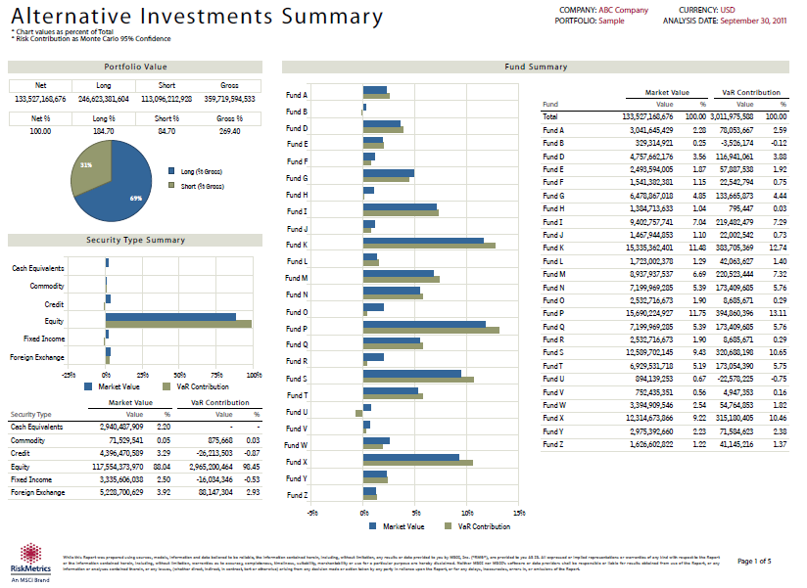
Hedge Fund Risk Aggregation
Utilize MSCI’s RiskMetrics tool to improve our analysis of PRIM’s Direct Hedge Funds

Slide 32
Hedge Funds and
Low Volatility Strategies
Eric R. Nierenberg, Ph.D.
Senior Investment Officer
Hedge Funds and Low Volatility Strategies

Slide 33
Eric R. Nierenberg, Ph.D.
Joined PRIM in December 2012
Previously worked as an equity analyst and portfolio manager
Adjunct Professor at Brandeis International Business School, teaching Investments, International Portfolio Management, and Options & Derivatives
A.B., M.A. and Ph.D., Harvard University
Specialization in behavioral finance (intersection of psychology and finance)

Slide 34
PRIM Hedge Fund Summary
Total Portfolio Value of $5.0 billion
$3.7 billion direct fund investments (21 managers)
$0.8 billion emerging manager fund of funds
$0.5 billion in fund of funds liquidation; capital to be redeployed over next 12-18 months

Slide 35
Portfolio Management
Lots and lots of meetings
Existing managers
Prospective managers
Market strategists
Hedge fund replication discussions (more on this later)

Slide 36
Risk Management
We have a well-diversified, risk-controlled hedge fund portfolio. That being said, there is always room to improve our monitoring and evaluation process
Working with PRIM’s Risk team, we are developing a comprehensive risk assessment system to aggregate and monitor hedge fund risk
These efforts will also provide us with better tools for performance attribution

Slide 37
Quantitative Analysis
While “kicking the tires” will remain important, we are striving to build a systematic framework for assessing hedge fund managers
Among the many potential benefits of this approach
Identify firms which can best complement the existing portfolio from a risk-return perspective
Understand how much alpha our current managers are producing, and where exactly it is coming from

Slide 38
Quantitative Analysis (continued)
A major goal of this work is to identify “hidden” sources of hedge fund market exposures
Sometimes referred to as “alternative beta”
In tandem, actively investigating the suitability of hedge fund replication strategies
Attempt to deliver the same risk-return profile of certain hedge fund strategies in a lower cost, more liquid investment vehicle

Slide 39
Further Initiatives – Project SAVE
For Project SAVE, reducing management fee levels associated with our hedge fund investments is a major piece of the equation. To that end, we are:
Scrutinizing fee arrangements with current managers to find ways to lower costs
New hedge fund investments going forward will be made at lower fee levels

Slide 40
Further Initiatives – Low Volatility
The “other” part of my title, but a very important responsibility
Focusing on volatility permits a more comprehensive analysis of proper asset allocation across the entire PRIT portfolio, not just the hedge fund portion. Some of our current projects include:
Researching the feasibility of investment mandates that might span multiple asset classes, such as fixed income and hedge funds
Designing an allocation framework that better balances the types of market risks found in the PRIT portfolio

Slide 41
Real Estate and Timberland
Timothy V. Schlitzer
Senior Investment Officer
Real Estate and Timberland

Slide 42
Real Estate Portfolio
Total portfolio market value – $4.8 billion (9.0% of PRIT)
Investment strategies
Core (Direct Properties)
Non-Core (Partnerships and Development)
Global REITs
Highly diversified portfolio
90+ directly owned properties (Retail, Office, Industrial, Apartment)
25+ markets
100+ stocks
12 investment managers
Low leverage – Debt currently 30% of total portfolio value

Slide 43
Real Estate Strategy
Targets
Core – 75%
Non-Core – 5%
REITs – 20%

Slide 44
Real Estate Market
Returns range from 6‐7% for assets
Cap rates are at historically low levels but at wider spreads to fixed income instruments and on lower net operating income (NOI) profiles
Transaction volume has increased to “normal” levels. More opportunities could come from recapitalizations
New supply remains at historic lows
Economic uncertainty exists. However, pockets of investment opportunity remain at the asset level and within specific markets where growth drivers exist
Core properties should remain attractive to investors in a low to moderate growth environment

Slide 45





Investment Themes

Slide 46
2013 Strategy
Implement Portfolio Debt
Take advantage of low interest rate environment to enhance core returns
Borrow at the portfolio level for best terms and maximum flexibility
Maintain low leverage strategy at 30-40%
Core Acquisitions
Invest debt proceeds of $1 billion
Evaluate criteria adjustments to expand opportunity set
REITs
Monitor global mandates implemented in 2012
Non Core
Monitor new apartment development projects
Continue to review new opportunities

Slide 47
Timberland Portfolio
Total portfolio market value – $1.4 billion
710,000 acres owned on 16 timber properties
Diversified portfolio
12 States
Australia (entered in 2012)
10+ Timber species grown
Multiple end uses
Domestic and international customers
Two timberland investment managers (TIMOs)

Slide 48
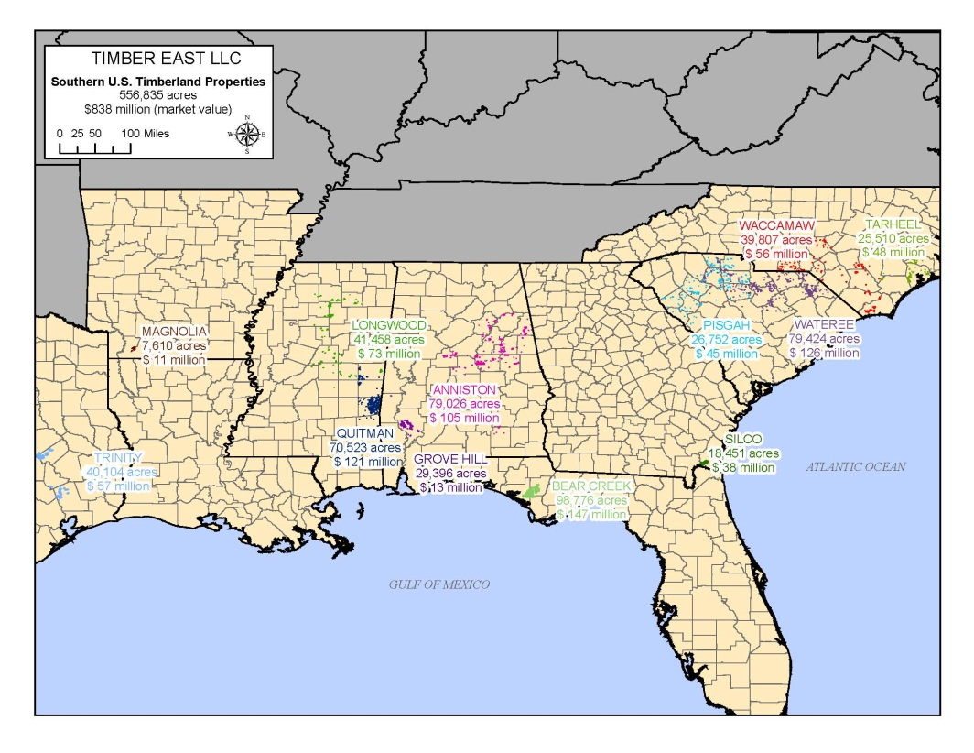
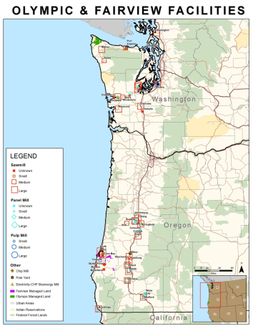
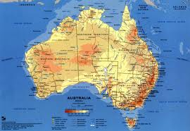
Timberland - Diversification

Slide 49
Timberland Market
Macro drivers favorable
Inventory age (renovation)
Population
Household formation (demand)
Log prices – bottomed in 2009, return to trend in 2014 – 2015
China’s influence remains significant in Pacific Northwest
Canadian imports declining (pine beetle)
Bid/ask spread narrowing
Transaction pricing at 5.5-6.5% real

Slide 50




Investment Themes

Slide 51
2013 Strategy
U.S.
Continue to grow exposure in Pacific Northwest
Monitor and potentially add to Southern allocation
International Timberland
Continue to review new pipeline opportunities
Monitor Forestry South Australia

Slide 52
Private Equity
Michael R. Bailey
Senior Investment Officer
Director of Private Equity

Slide 53
PRIM Private Equity Investment Team
Name | Title | Joined PRIM | Years In Industry | Prior experience
Michael Bailey | Director | February 2013 | 26 | HighVista
Scott Hutchins | Senior Investment Officer | January 2010 | 10 | Liberty Mutual
Peony Keve | Investment Officer | July 2008 | 17 | Putnam Investments
Open Position | Investment Officer | - | - | -
Hamilton Lane, a global private equity firm with more than 190 employees, has been PRIM’s private equity consultant since 2007.

Slide 54
Michael R. Bailey, Director of Private Equity
HighVista Strategies, Director of Manager Selection
Lucent Asset Management, Director of Private Equity
Deutsche Bank and J.P. Morgan, investment banking
BA, Northwestern University

Slide 55
Private Equity Performance
Objective: generate long-term returns that are 3% higher than U.S. equities
Source: Mellon Monthly report as of 3/31/13; time-weighted annualized gross returns

Slide 56
Alternative Fixed Income Performance
Objective: Generate long-term returns that are higher than U.S. and non-U.S. credit markets
Source: Mellon Monthly report as of 3/31/13; time-weighted annualized gross returns

Slide 57
PRIM’s Private Equity Program is Well Diversified
$7.4 billion market value
$6.1 billion Private Equity
$1.3 billion Alternative Fixed income
Source: Diversification-MassPRIM and Hamilton Lane as of 9/30/12; Value- Mellon as of 3/31/13

Slide 58
Private Equity Managers Have Large Dispersion Between Top- and Bottom-Performers
First quartile minus third quartile: 16% average
First quartile minus median: 7% average

Slide 59
Investment Initiatives Going Forward
Private Equity
Small and middle market firms
Industry-focused, such as energy and healthcare
Co-investments
Alternative Fixed Income
Direct lending
Distressed for control
Real assets

Slide 60
Project SAVE Strategic Analysis for Value Enhancement
Timothy L. Vaill, PRIM Investment Committee
2013 PRIM Investor Conference
May 9, 2013

Slide 61
Agenda
Introduction
Background
Project SAVE Objective
Process and Next Steps
Time Schedule

Slide 62
I. Introduction
PRIM’s investment returns continue to be strong
13.88% in calendar year 2012
10-year average return of 8.65%
Major staffing and compensation issues recently addressed
Michael G. Trotsky, CFA, serving as both ED and CIO
Key senior hires now in place
Funding requirements provide continuing challenge
Actuarial target needs to be fulfilled
PRIM expenses a key component
The PRIM Board directed an expense analysis
No firm-wide cost study for 20+ years

Slide 63
II. Background
PRIM FY 2012 actual expenses: $242.5 million (50 bps)
98% “outside the four walls” of PRIM
Investment management fees
Consulting fees
Audit, custody, legal, etc.
Anomaly: PRIM fees grow as asset values increase
Many under contracts tied to AUM
Mutual funds lowering fees
Public funds under pressure

Slide 64

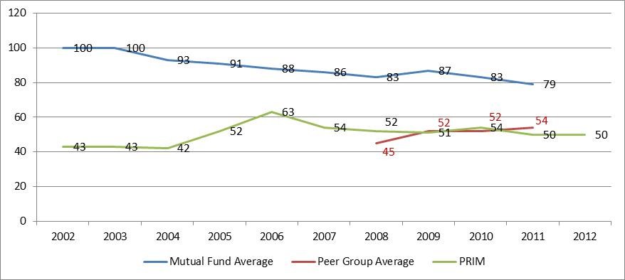
PRIM Overall Expense Comparison

Slide 65
PRIM Expense by Asset Class

Slide 66
III. Project SAVE Objective
Understand/Analyze/Evaluate the expense structure of PRIM
Examine existing external fee arrangements
Examine alternative investment approaches
Recommend ideal configuration of activities to optimize costs
Benefit plan participants and state taxpayers
Maintain overall return and risk characteristics

Slide 67
Example: Hedge Fund Expenses
PRIM is reducing its “Fund of Funds” hedge manager program
Elimination of management layer; Increase transparency
Strengthen in-house oversight responsibility
Saved 85 bps annually on hedge fund portfolio
Result > $30 million in expenses
Impact on returns
Minimum: Fee savings
Long-term: Neutral/Positive

Slide 68
IV. Process and Next Steps
Examine all PRIM cost components
Undertake benchmark comparison study
CEM Benchmarking, Inc.
Peer Group: 19 U.S. public plans from $21 to $75 billion
Visit comparable public funds to review ideas
Identify short-term and long-term measures
Analyze financial impact

Slide 69
Approach: For Each Asset Class We Want to Ask
Can we renegotiate fees with existing third-party managers?
Should we include more performance-based fees?
Should we consider a “Co-Investment” strategy?
Should we consider being a direct investor?
Should the mix of active/passive be adjusted?
Are there certain investment functions that should be brought in house?

Slide 70
Maintain Balance
Return
Actuarial
Absolute
Ongoing
Qualitative
One-Time
Quantitative
Risk
Cost

Slide 71
V. Time Schedule
Q1/Q2 2013: Internal data collection/information gathering
Q2/Q3 2013: Benchmarking study; Marketplace comparisons
Q3/Q4 2013: Formulate action steps and timing
2014: Implementation
(Note: Short-term actions may happen sooner)

Slide 72
Keynote Speaker
“Rethinking the Pension Fund Business Model”
Keith Ambachtsheer
Director of Rotman International Centre for Pension Management
Rotman School of Management, University of Toronto
Steven Grossman, Treasurer and Receiver General, Chair
Michael G. Trotsky, CFA, Executive Director and Chief Investment Officer

Slide 73
Rethinking the Pension Fund Business Model a
Keith Ambachtsheer
Director, Rotman International Centre for Pension Management
Rotman School of Management, University of Toronto
May 9, 2013

Slide 74
The Drucker Pension Organization
Fiduciary mandate -> ‘for the sole benefit of...’
Strong governance and executive functions
Sensible investment beliefs
Right-scaled
Attract/retain top professional team

Slide 75
Implications – Governance
Legitimacy → Representativeness
Competence → Skills/Experience Matrix
Pension organizations need ‘Legitimacy’ and ‘Competence’ on their Boards
‘Legitimacy’ or ‘Competence’ is a false choice

Slide 76
Implications – Investment Beliefs
‘Return-Seeking’ vs. ‘Payment-Certainty’ Investing
‘Return-Seeking’: ‘Beauty Contest’ vs. ‘Wealth Creation’
‘Payment-Certainty’: Duration? Inflation-Sensitivity?

Slide 77
Implications – Scale
Economies of Scale in public markets investing?
Economies of Scale in private markets investing?

Slide 78
Implications – Top Professional Team
Levelling the informational playing field
Implications for compensation levels and structures?
Implications for performance measurement?
Optimal insource/outsource ratios?

Slide 79
New GASB Pension Reporting Requirements
Greg Driscoll
KPMG
Partner
Department of Professional Practice
Steven Grossman, Treasurer and Receiver General, Chair
Michael G. Trotsky, CFA, Executive Director and Chief Investment Officer

Slide 80
2013 PRIM Investor Conference GASB Pension Accounting and Financial Reporting Standards
Greg Driscoll
KPMG LLP
Partner
May 9, 2013

Slide 81
Overview of the Pension Standards
New pension standards are part of project undertaken to reexamine standards related to postemployment benefits in order to improve:
Accountability and transparency related to postemployment benefits
Decision-making usefulness of information related to postemployment benefits for users of the financial statements
Project is in 2 phases:
Phase 1 deals with pension benefits
Phase 2 deals with OPEB (currently under deliberations)
In June 2012, GASB completed Phase 1 issuing two new standards related to pensions:
GASB Statement No. 67, Accounting and Financial Reporting for Pension Plans
GASB Statement No. 68, Accounting and Financial Reporting for Pensions
The Pension Standards are effective as follows:
GASB 67 for fiscal years beginning after June 15, 2013
GASB 68 for fiscal years beginning after June 15, 2014
Notes:
Identify the projects on GASB’s Research Agenda as detailed on the slide. Provide a background on each project and briefly describe its current status. Refer to www.gasb.org for descriptions of the projects on GASB’s Technical Agenda.

Slide 82
Overview of Employer Standard
Key conceptual shift in reporting pension liabilities and expense under the economic resources measurement focus –from a “funding” approach to an “earnings” approach:
Currently, no liability is reported if government 1) fully funds its annual required contribution (single-employer and agent plans) or 2) pays its contractually required contribution (cost-sharing plan)
Under new approach:
Pension liability is reported as employees earn their pension benefits by providing services
Changes in pension liability are recognized immediately as pension expense or reported as deferred outflows/inflows of resources depending on nature of change
No significant changes to accounting for pensions in governmental funds
Substantive changes to methods and assumptions used to determine actuarial information for GAAP reporting purposes:
The actuarial methods and assumptions allowable under current standards may continue to be used to determine funding amounts
Notes:
Identify the projects on GASB’s Research Agenda as detailed on the slide. Provide a background on each project and briefly describe its current status. Refer to www.gasb.org for descriptions of the projects on GASB’s Technical Agenda.

Slide 83
Net Pension Liability
Employers should report in their financial statements a net pension liability (asset), determined as of a date no earlier than the end of the employer’s prior fiscal year (measurement date) for each defined-benefit pension plan in which they participate
Net pension liability (asset) equals the total pension liability for the pension plan, net of the plan’s fiduciary net position:
Total pension liability is the actuarial present value of projected benefit payments attributed to past employee service
Plan’s fiduciary net position is determined using same valuation methods as used for plan’s GAAP financial reporting
Total Pension Liability
Less: Plan’s fiduciary net position
Net Pension Liability
Notes:
Identify the projects on GASB’s Research Agenda as detailed on the slide. Provide a background on each project and briefly describe its current status. Refer to www.gasb.org for descriptions of the projects on GASB’s Technical Agenda.

Slide 84
Determining Pension Expense and Deferred Inflows/Outflows of Resources
Certain aspects of the change in net pension liability should be recognized immediately as pension expense, and others should be recognized as deferred outflows/inflows of resources and amortized into pension expense over time.
Employers participating in single-employer or agent multiple-employer plans will recognize 100 percent of the pension expense and deferred amounts determined for each plan.
Employers participating in cost-sharing plans will recognize their proportionate share of the collective pension expense and deferred amounts determined for the plan as a whole.
As a general rule, more aspects of the change in net pension liability will be reported immediately as expense than were immediately incorporated in the annual required contribution under current guidance.
Notes:
Identify the projects on GASB’s Research Agenda as detailed on the slide. Provide a background on each project and briefly describe its current status. Refer to www.gasb.org for descriptions of the projects on GASB’s Technical Agenda.

Slide 85
Changes in Net Pension Liability Immediately Recognized as Pension Expense
Changes in the Total Pension Liability
Changes in Plan’s Fiduciary Net Position
Current period service cost
Projected earnings on plan investments
Interest on the beginning total pension liability
Changes in plan fiduciary net position other than employer contributions and benefit payments (e.g. employee contributions, admin costs)
Impact of changes in benefit terms
Conceptually, the effect of employer contributions made directly by the employer should not be recognized as expense.

Slide 86
Changes in Net Pension Liability Resulting in Deferred Inflows/Outflows of Resources
Changes in the Total Pension Liability
Changes in Plan’s Fiduciary Net Position
Effects of actuarial differences and changes in assumptions related to economic or demographic factors attributable to active and inactive employees, including retirees
Differences between actual and projected earnings on plan investments
Recognize as deferred inflow/outflow and amortize over a closed period equal to the average of the expected remaining service lives of all employees (active, inactive, and retirees)
Recognize as deferred inflow/outflow and amortize over a closed five-year period—report amounts from multiple years, net
Employer contributions made directly by the employer subsequent to the measurement date of the net pension liability and before the end of the employer’s fiscal year should be recognized as a deferred outflow of resources.

Slide 87
Overview of Pension Plan Standard
For pension plan financial statements:
Recognition, measurement, and presentation of financial statement amounts generally similar to current guidance:
Change limiting receivables to contributions due pursuant to legal requirements
Significant new note disclosure requirements:
Information on composition of pension board as part of Plan description
Annual money-weighted rate of return on plan investments
Information on deferred retirement option program (DROP) balances
Components of net pension liability (asset) as of the Plan’s fiscal year-end
Significant assumptions used to measure total pension liability, including substantial disclosures related to the discount rate
Required supplementary information:
Ten-year schedule of changes in the net pension liability (asset)
Ten-year schedule of components of net pension liability (asset)
Ten-year schedule related to employer contributions, if an actuarially-calculated employer contribution is determined
Ten-year schedule of the annual money-weighted rate of return on plan investments
Notes:
Identify the projects on GASB’s Research Agenda as detailed on the slide. Provide a background on each project and briefly describe its current status. Refer to www.gasb.org for descriptions of the projects on GASB’s Technical Agenda.

Slide 88
KPMG Government Institute Webcasts
Two 2-hour webcasts on the new GASB Pension Standards, along with other GASB-related webcasts, can be accessed on demand at KPMG’s Government Institute website:
http://www.kpmginstitutes.com/government-institute/

Slide 89
CFA Institute
Asset Manager Code of Professional Conduct
Robert W. Dannhauser, FRM, CAIA, CFA
Head, Standards of Practice and Outreach
CFA Institute
Steven Grossman, Treasurer and Receiver General, Chair
Michael G. Trotsky, CFA, Executive Director and Chief Investment Officer

Slide 90
Raising the standard of practice of investment managers Massachusetts PRIM
Bob Dannhauser, CFA, FRM, CAIA
Head, Standards of Practice and Outreach
May 9, 2013

Slide 91

Ethical Landscape
Market collapse was devastating to faith and confidence in the investment industry
Functioning capital markets depend on trust
Trust is earned through ethical conduct
Ethics are fundamental to market integrity
Clients demand ethical conduct from managers – not just good performance

Slide 92
Financial Services Fare Worst--Again
How much do you trust the following industries to do what is right?
91
Source: 2013 Edelman Trust Barometer

Slide 93
Alignment of expectations and performance
How important are each of the following actions to building trust?
Source: 2013 Edelman Trust Barometer®

Slide 94
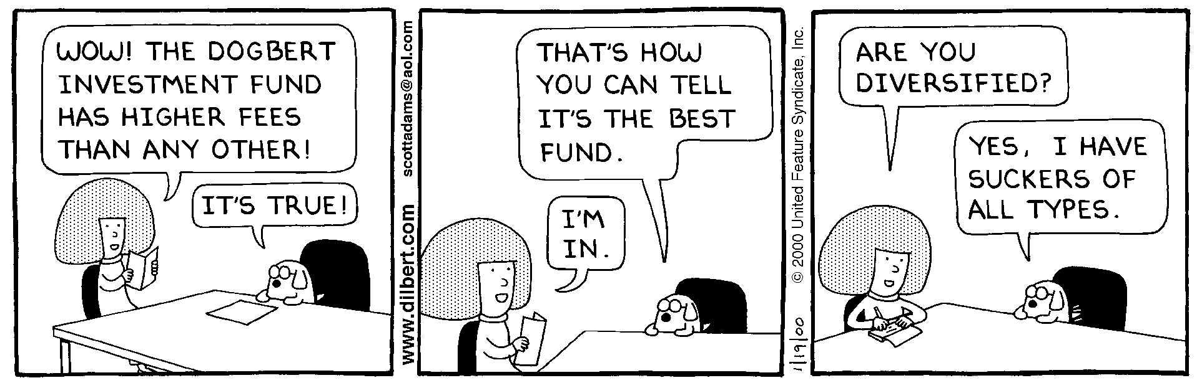

Investor Perceptions
DILBERT© Reprinted by permission of United Feature Syndicate, Inc.

Slide 95
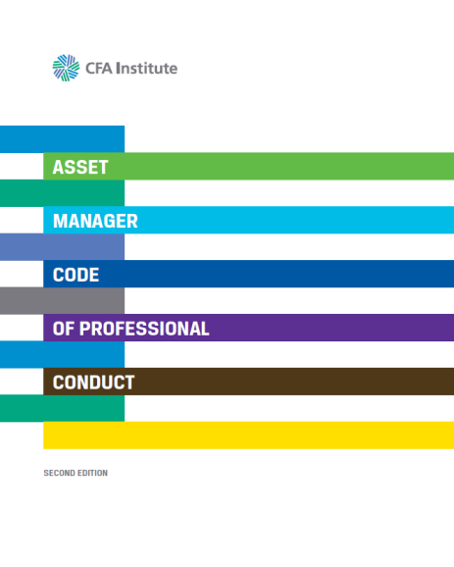
CFA Institute Asset manager code of professional conduct
Restores investor confidence through:
Voluntary best practice code of conduct for firms
Principle-based, allows flexibility in implementation
Global standard of professional conduct

Slide 96
Fundamental Ethical Principles
Client interests come first
Preservation of confidentiality
Avoid/manage conflicts of interest
Full and fair disclosure
Fair dealing
Reasonable care and prudent judgment
Maintain independence and objectivity

Slide 97

ASSET MANAGER CODE OF PROFESSIONAL CONDUCT
A. Loyalty to Clients
B. Investment Process & Actions
C. Trading
D. Risk Management, Compliance,
and Support
E. Performance and Valuation
F. Disclosures
Notes:
96

Slide 98
The Market Makes It Happen
Ask about compliance in RFPs and due diligence
Refer questions to CFA Institute: ethics@cfainstitute.org
Questions?
Bob.dannhauser@cfainstitute.org
212.705.1723

Slide 99
Inflation, Interest Rates, and Monetary Policy
Sarah N. Samuels, CFA
PRIM Senior Investment Officer – Public Markets
Constance M. Everson, CFA
PRIM Investment Committee
Managing Director, Capital Markets Outlook Group
Edward H. Ladd
Chairman Emeritus, Standish Asset Management
Steven Grossman, Treasurer and Receiver General, Chair
Michael G. Trotsky, CFA, Executive Director and Chief Investment Officer

Slide 100
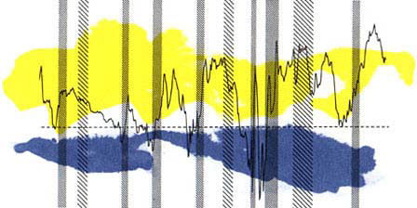
CAPITAL MARKETS OUTLOOK GROUP, INC.
Mass PRIM Investor Conference
May 9, 2013

Slide 101
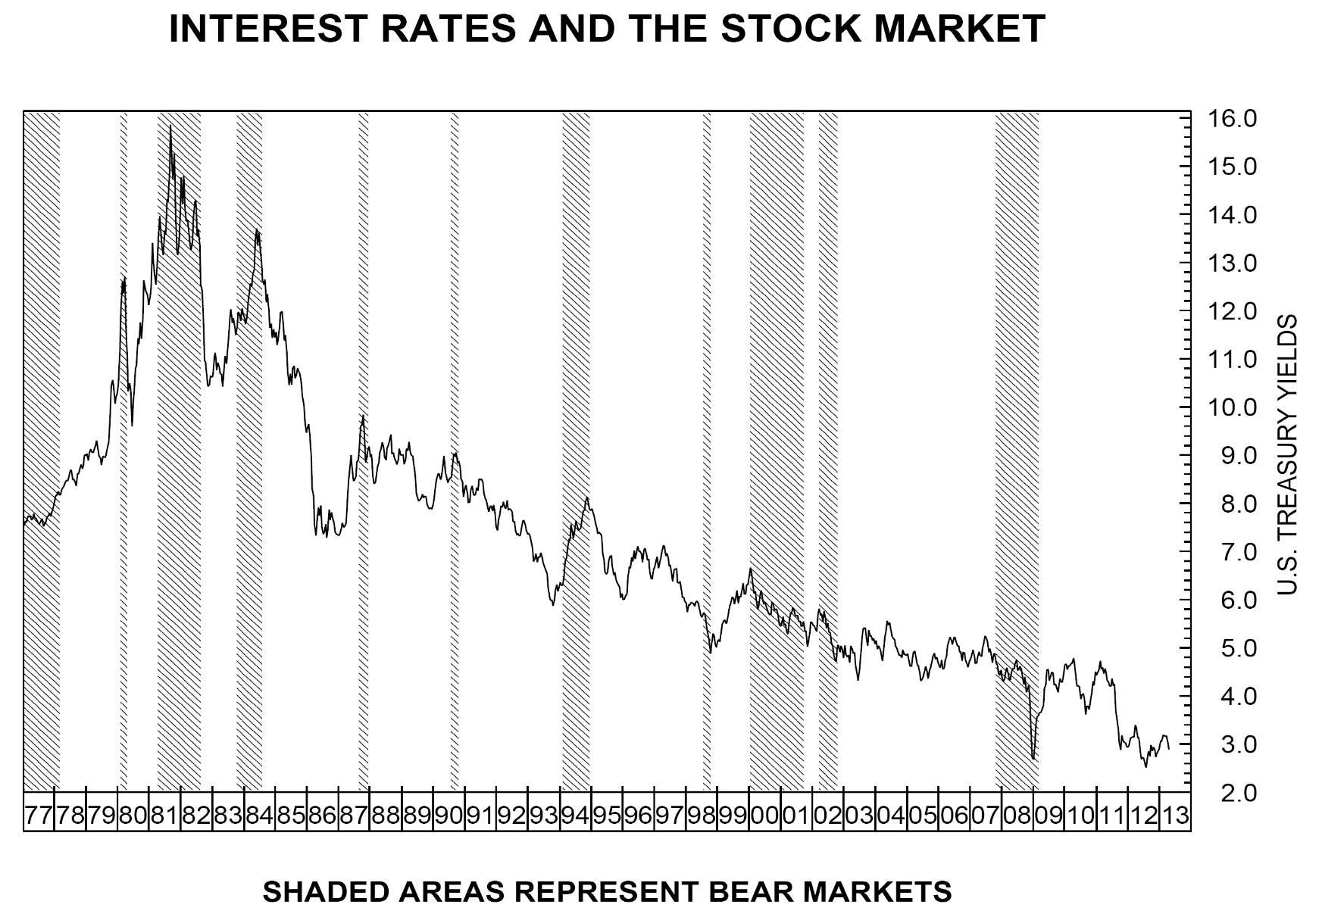
30-Year Treasury Yields

Slide 102
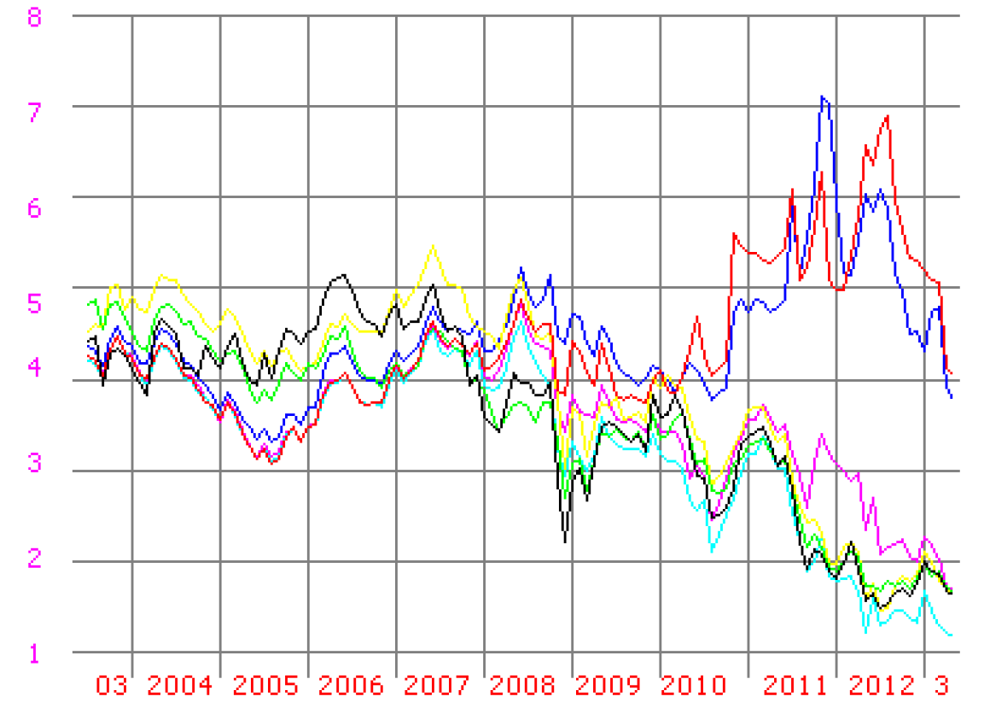
10-YEAR YIELDS: SPAIN ITALY CANADA UK FRANCE GERMANY USA

Slide 103
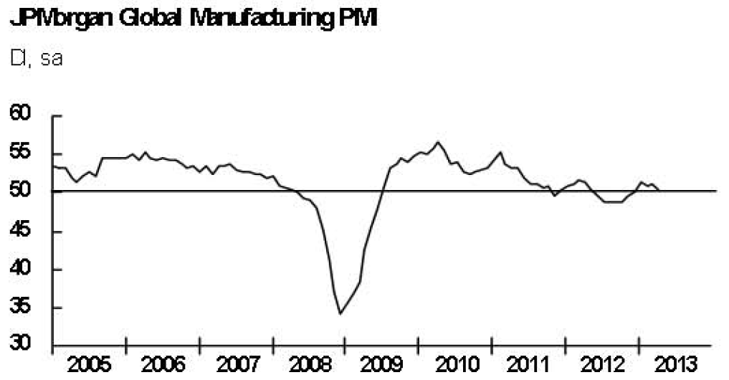
JP Morgan Global PMI

Slide 104
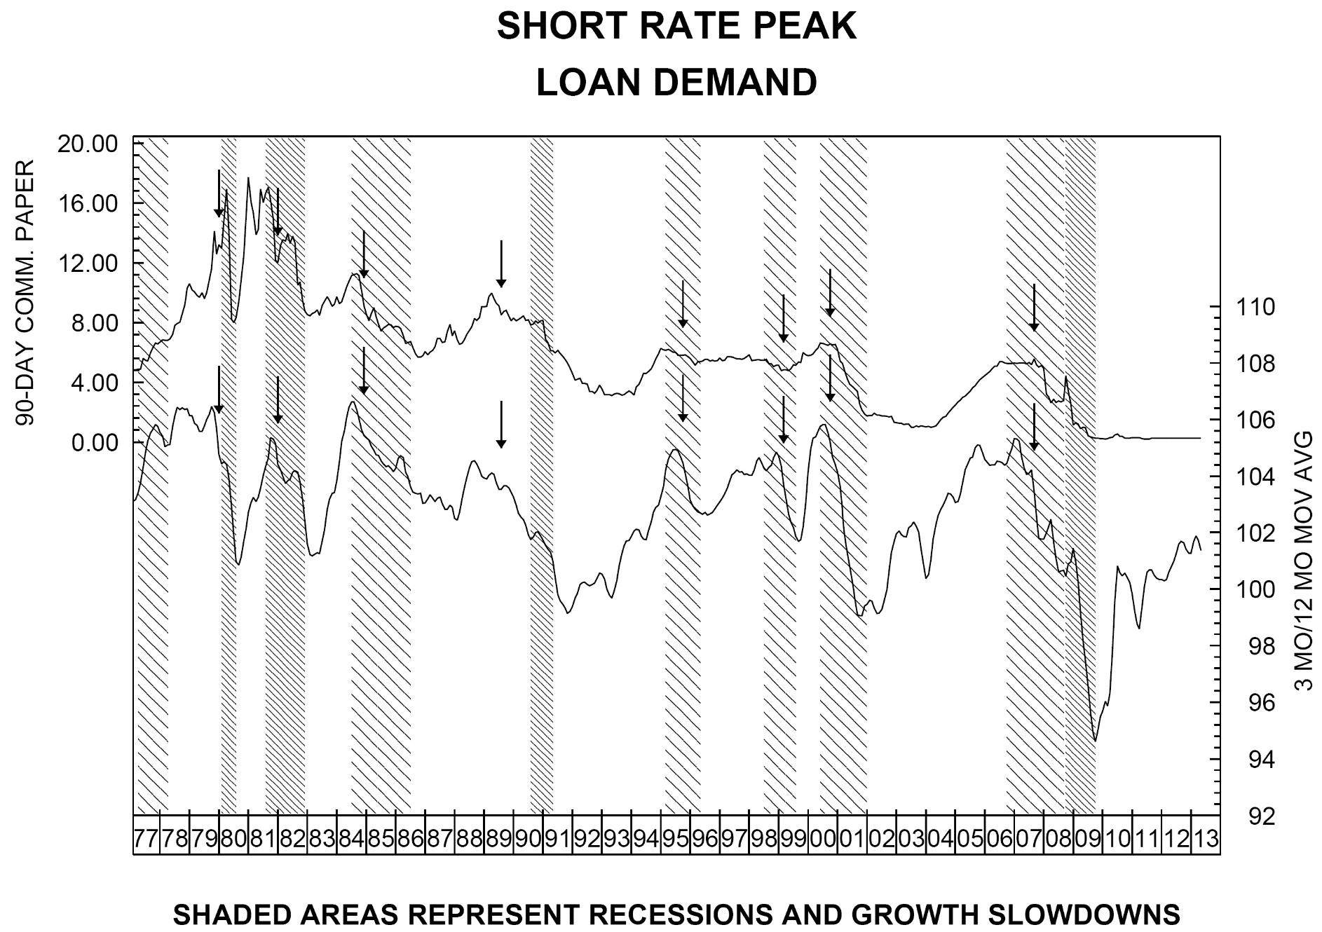
Loan Demand 3/12

Slide 105
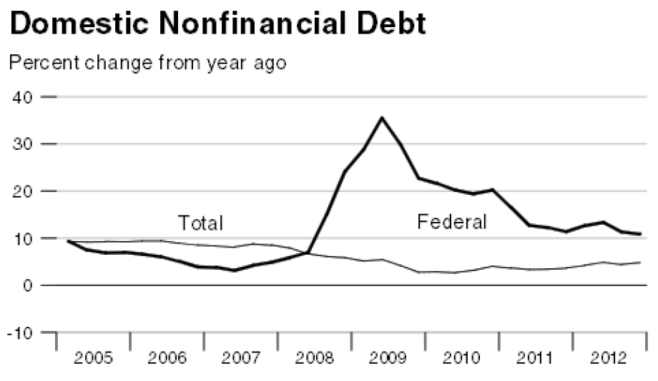
Nonfinancial debt

Slide 106
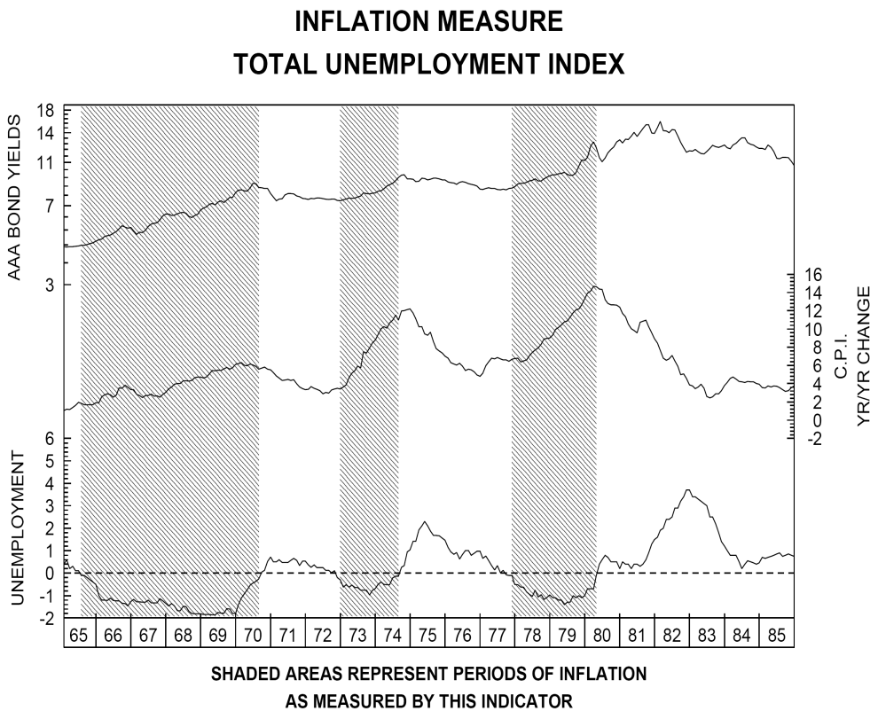
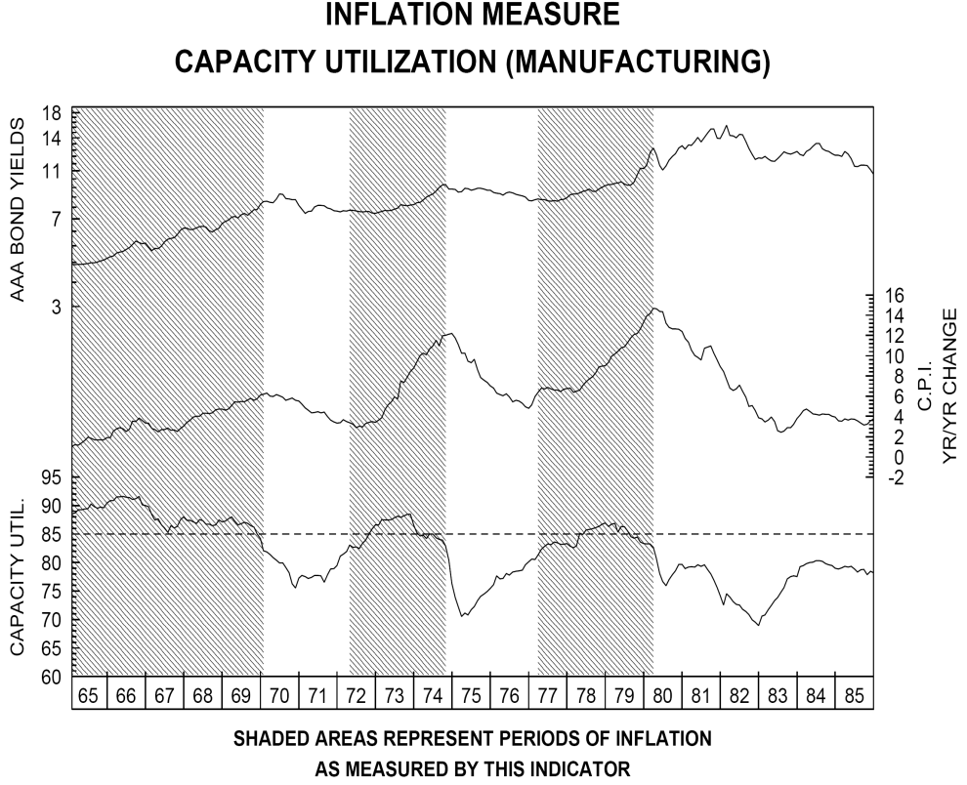
INFLATION WARNINGS 1965-1985

Slide 107
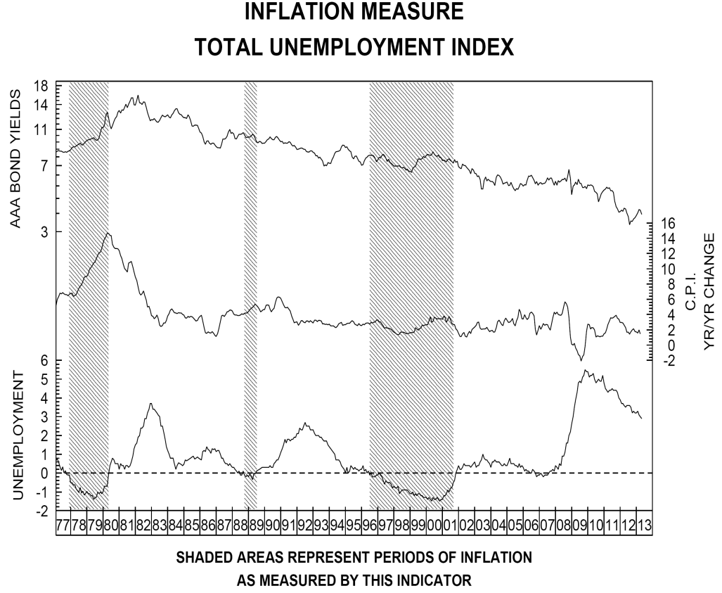
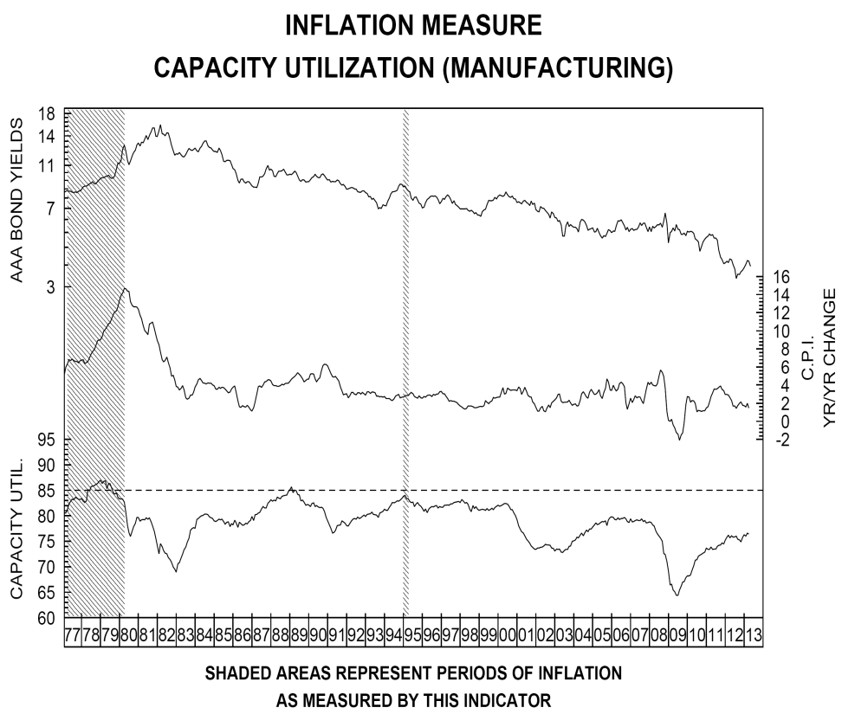
CURRENT SITUATION

Slide 108
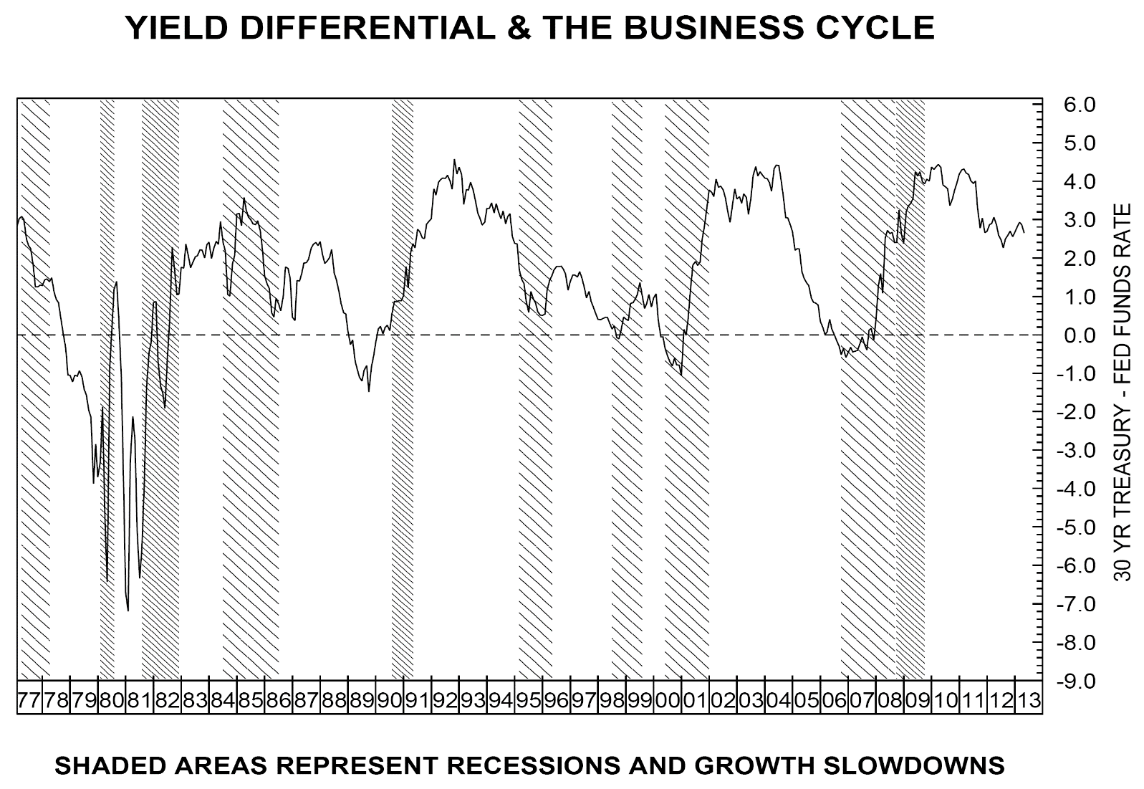
Yield Differential

Slide 109
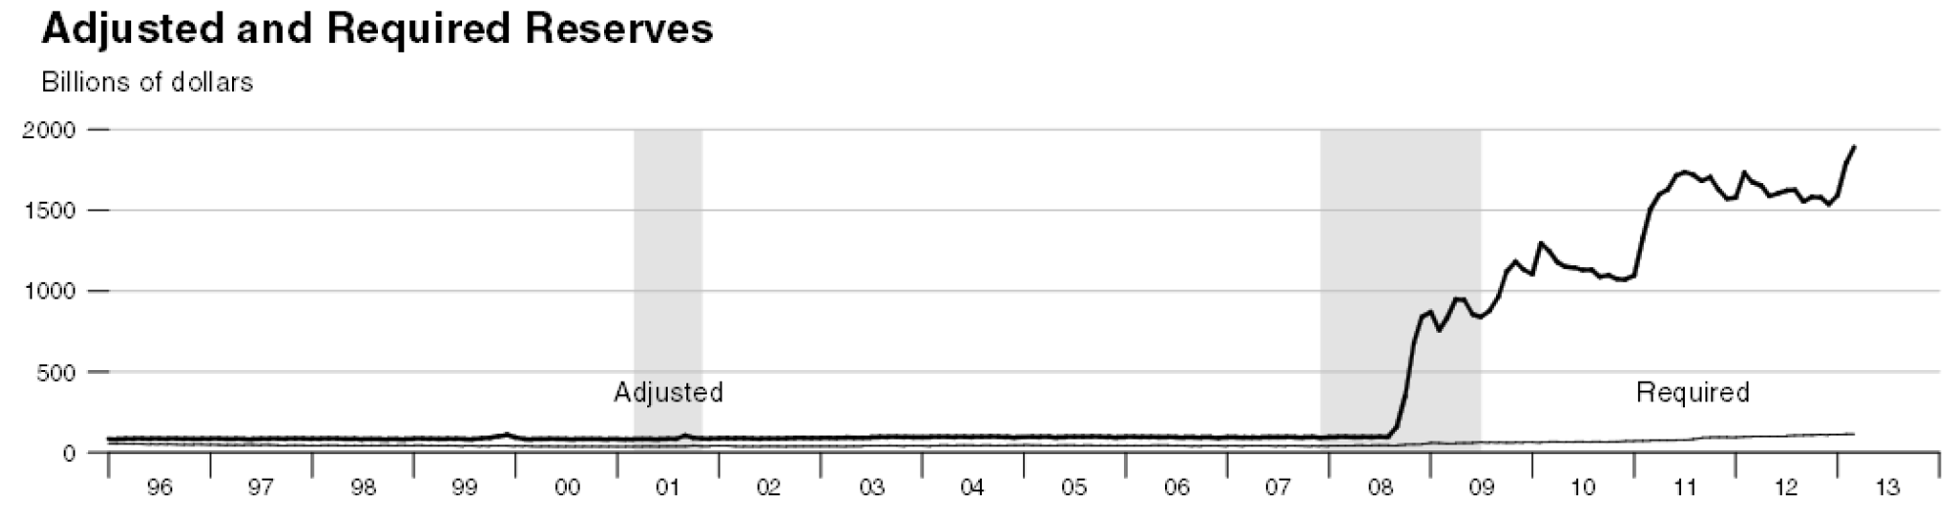
Excess Reserves

Slide 110
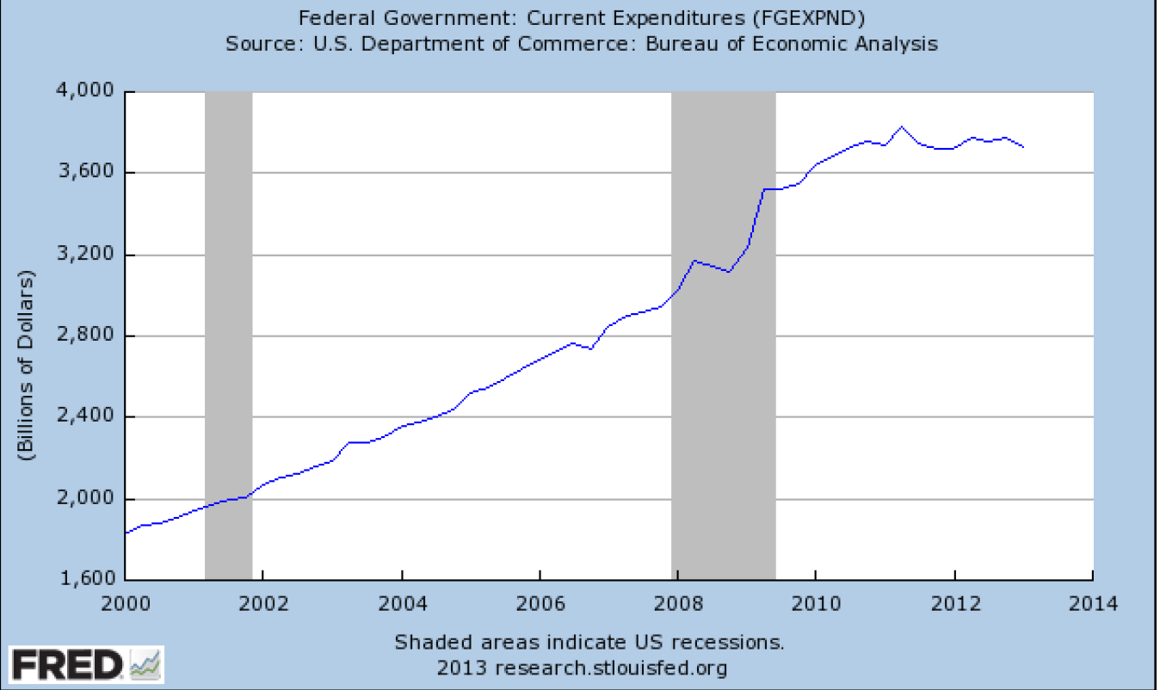
Federal Expenditures

Slide 111
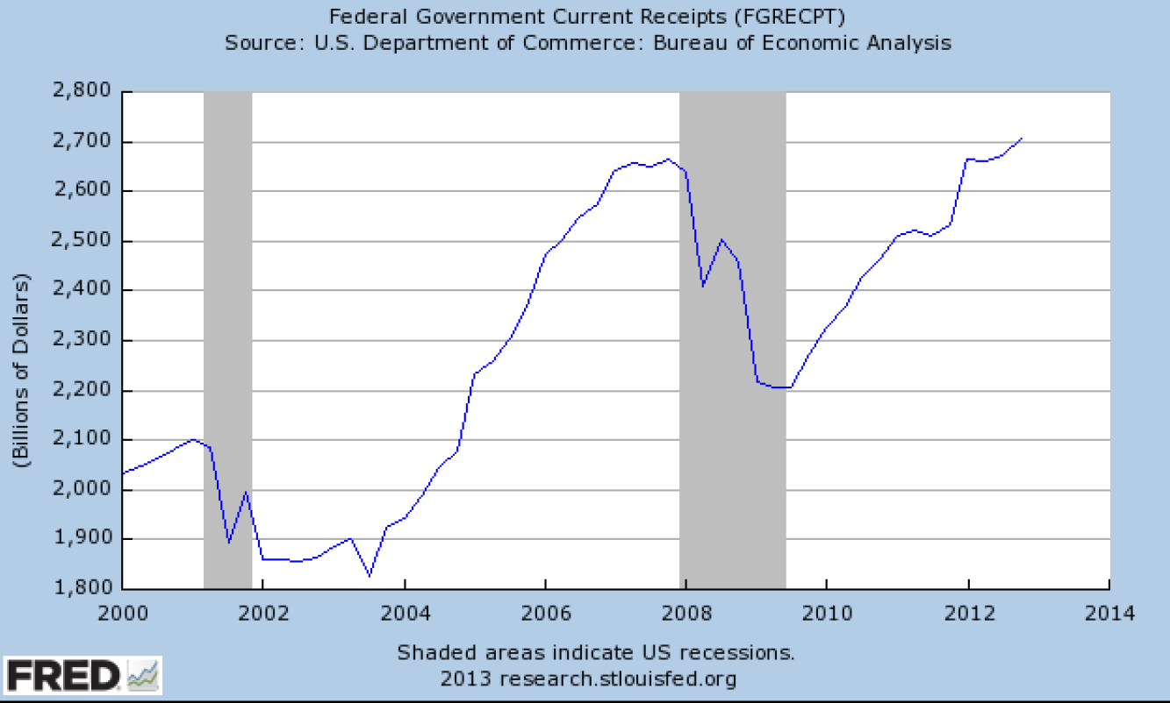
Federal Government Receipts

Slide 112
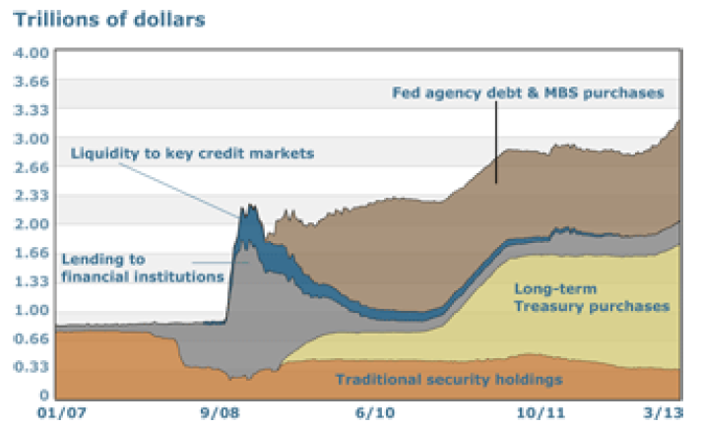
Fed Balance Sheet

Slide 113
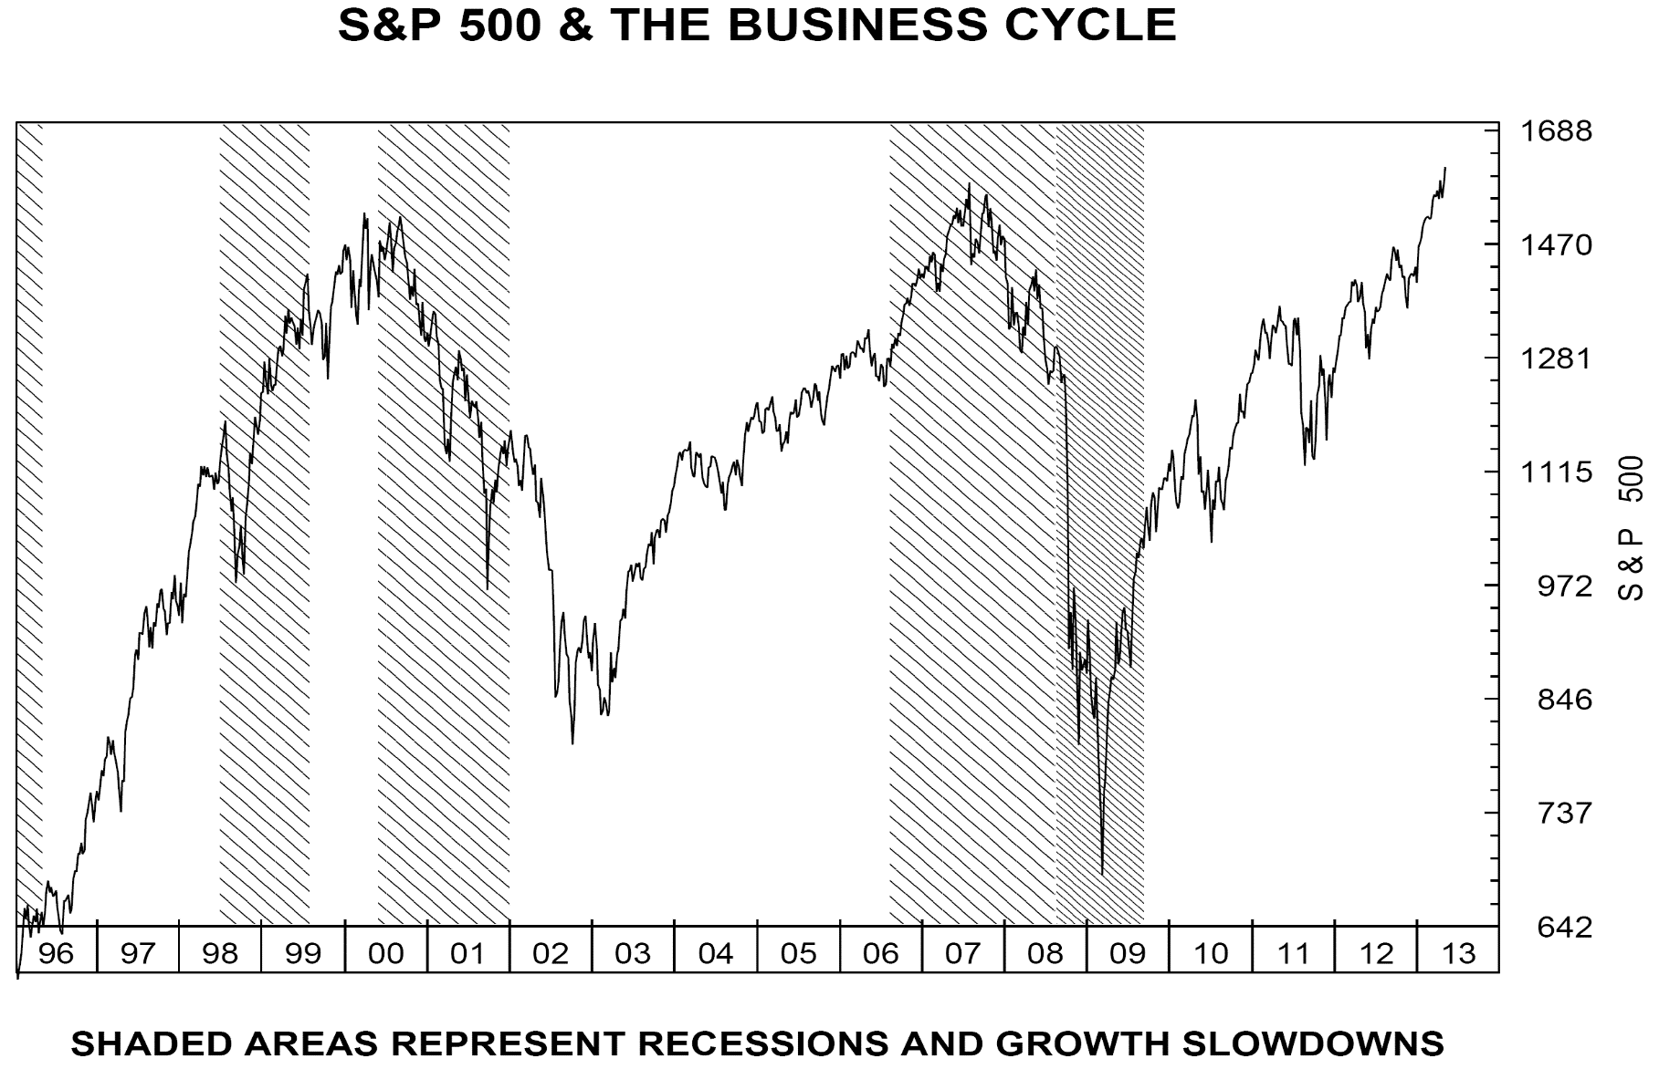
S&P 500

Slide 114
Keynote
“Real Estate’s Role in Pension Plan:
Is Real Estate an Inflation Hedge?”
Jacques Gordon
Head of Research and Strategy, Global
LaSalle Investment Management
Steven Grossman, Treasurer and Receiver General, Chair
Michael G. Trotsky, CFA, Executive Director and Chief Investment Officer

Slide 115
Real Estate Investment Outlook
LaSalle Investment Management
Jacques Gordon

Slide 116
Topics
US Economic and Real Estate Outlook
Real Estate as an Asset Class
Global Real Estate
Investment Examples
Notes:
Was asked to talk about why invest in real estate
Want to touch on a few different topics
But was also thinking this morning about what is real estate?
Dictionary definition is: property in buildings and land …but what we are talking about here is real estate as an investment.

Slide 117
US Economic Outlook for 2013
Tailwinds
Housing recovery
Energy and natural resources
Technology, Life Sciences
Headwinds
Public sector job cuts and furloughs
European recession
Fiscal and monetary uncertainty
U.S. GDP Growth
Source: Global Insight as of 25 April 2013
Notes:
Base case: another year of subpar 2% growth in 2013.
Potential upside due to housing and energy.
Most likely fiscal cliff scenario: 6-12 month extension of most tax cuts and deferal of spending cuts. Going off fiscal cliff will lead to short recession, but not likely.

Slide 118
Private Employment Growth Above Expectations 165,000 Jobs Added in April After Solid First Quarter
Change in Quarterly Payroll
Q 1 strong, slowdown in March
Sequester Impacts still to come
Source: BLS, Global Insight, Economy.com, LaSalle Investment Management Data through Mar 2013; Forecast as of 5 Apr 2013

Slide 119
Home Prices are Rising
Rebound driven by low mortgage rates and lack of inventory
Home price growth has been positive for over a year according to the 12-month average of the NAR Index. Price growth has been positive for seven months according to the Case-Shiller Index.
While prices seemed to turn a corner in early 2010 before falling further over the past two years, that seems less likely this time around: the supply of for-sale housing has begun to drop and housing starts are positive.
Source: Economy.com Case-Shiller data through January 2013
NAR data through February 2013
Notes:
This slide uses the Case-Shiller 20-metro composite in lieu of the national index because the 20-metro composite is released more regularly. In general, the Case-Shiller 20-metro composite is 10 index points higher than the national index, but rises and falls with the national index. This pattern results in year-over-year change in the 20-metro composite and the national index tracking very closely.

Slide 120
Home Price Recovery by Metro
Worst Hit Metros See Strongest Price Growth
Recovery: Trough to Current Price Recovery
Recession: Peak to Current Price Decline
Source: Case Shiller, Economy.com Data through January 2013
Notes:
Mining & Natural Resources is off the charts at 25.7% trough to current recovery due to boom in petroleum industry.

Slide 121
Apartments & Shopping Centers: Strong Income Growth
Steady recovery is forecast for other property types
Forecast
*Four-quarter same-store NOI growth/decline.
Source: NCREIF, LaSalle Investment Management As of 4Q2012

Slide 122
New Supply Below Average, Except Apartments Apartment Deliveries Will Rise Above Average in 2013
Financing remains a major barrier to construction projects, with the exception of some apartment markets.
The apartment sector is forecast to pass its average construction levels far ahead of the other sectors.
*Retail includes shopping centers and malls
Source: CBRE-EA (Sum of Markets), PPR (Top 54), LaSalle Investment Management, Jones Lang LaSalle As of 4Q:2012

Slide 123
US Real Estate Values Remain 20% below Peak
Major Market CBD offices and Apartments seeing strongest recovery
Real Estate Values
Pricing trends indicate rebound opportunities remain outside of the major markets
Source: Moody’s/RCA CPPI Data through 4Q 2012
Note: Major Markets defined as Boston, New York, Washington DC, Chicago, San Francisco and Los Angeles
Notes:
Source: IPD, NCREIF (US) Quarterly data Japan to 2Q 2012, all other markets through 3Q 2012
Note: IPD’s quarterly returns for Australia, Canada, and Japan are presented only on a rolling annual basis; the quarter-over-quarter series has been estimated
Series are adjusted to remove the impact of capital expenditures

Slide 124
Transaction Volume Back to Normal
U.S. Real Estate Transaction Volume
The jump in year-end transactions pushes 2012 volume to $233 billion, above 2004 levels. This is the third consecutive year of double-digit percentage increases.
Large portfolio transactions helped boost volume in 2012, and are likely to continue into 2013.
Source: Real Capital Analytics Note: Excludes privatizations. Data through March 2013
Only includes transactions with a grossed up value of $5 MM and greater,

Slide 125
Boston Economy Outperformance in 2013
Source: Moody’s Analytics, Global Insight, LaSalle Investment Management

Slide 126
Technology: A Major Driver of Boston Growth
Source: Global Insight, LaSalle Investment Management

Slide 127
Boston Commercial Real Estate to Outperform
LaSalle Target Market Rank (out of 74)
Market | Office | Warehouse | Apartments
Boston – Central | 10 | 49 | 1
Los Angeles – Downtown | 23 | 8 | 12
New York – Midtown | 4 | 6 | 2
San Francisco – Downtown | 2 | 64 | 5
Washington, DC – District of Columbia | 12 | 46 | 24
Source: Global Insight, LaSalle Investment Management

Slide 128
Income-Earning Real Estate
An Important Contributor to a Pension Plan Portfolio
Portfolio benefits
Private direct real estate diversifies stock and bond positions
Real estate can be an inflation hedge
Steady rental income helps pay liabilities
Economic conditions favorable for real estate
Low interest rates enables low cost borrowing
Risk aversion means limited new construction and little new competition
Interest Rate Risk
Mid to long-term increases in interest rates could hurt real estate values
Risk partially offset by economic and real estate income growth
Price Recovery Incomplete
Investor interest has driven strong recovery in gateway markets
Most markets have pricing well below peak levels

Slide 129
Performance of Core, Direct Real Estate Risk Adjusted Return Ratios
15 Year Analysis (1Q 1998 – 4Q 2012)
 | Average Annual Return | Standard Deviation | Sharpe Ratio
Core Real Estate | 8.1% | 7.4% | 0.75
Large Cap Stocks | 4.5% | 18.5% | 0.11
Corporate Bonds | 6.8% | 5.2% | 0.83
Public Real Estate | 8.9% | 22.9% | 0.28
3 Month T-Bills | 2.5% | 1.0% | -
Note that private real estate values are based on quarterly appraisals.
Sources: Core Real Estate: NCREIF ODCE; Public Real Estate: NAREIT Equity REITs; Large Cap Stock: S&P 500; Corporate Bonds: Citigroup Investment Broad Investment Grade Bond Index; Standard deviation is based on quarterly returns. Risk free rate is 3-month T Bill. Data as of 4Q 2012

Slide 130
Institutional Real Estate Fast Growing Asset Class
Two broad measures of real estate investment indicate that it has grown more than twice as fast as the asset base of either households or pension funds.
This trend indicates an increasing allocation to institutionally managed real estate by investors
Source: Federal Reserve Flow of Funds, NCREIF, NAREIT
Real Estate Data through 2012, Federal Reserve Data through 3Q 2012

Slide 131
Real Estate an Attractive Source of Income
Cash Returns Slightly Higher than Several Years Ago
Sources: Bloomberg, NCREIF, LaSalle Investment Management

Slide 132
Real Estate Can be an Inflation Hedge Income has kept pace with Inflation when fundamentals are in equilibrium
Real Estate Income
Inflation
Property types inflation hedging characteristics differ based on lease structure and demand drivers.
Inflation hedging depends on landlord leverage to raise rents, strongest when inflation caused by economic growth
Sources: Bureau of Labor Statistics, NCREIF
Notes: As of 4Q 2012 . Real Estate Income is the same-store NOI series of quarterly real estate income change.

Slide 133
US Real Estate Spreads to Corporate Bonds Above Average
Real Estate Yield Spread to Baa Bond
Current Spread = 126 bps
15 Year Average Spread = 35 bps
Real estate income yields have closely tracked Baa corporate bond spreads, except during the GFC.
The current spread is above the long term average, indicating possible cap rate compression.
Note: NCREIF data excludes hotels.
Source: Moody’s Economy.com, Federal Reserve, NCREIF, LaSalle Investment Management As of 4Q 2012

Slide 134
Macro Themes and Real Estate Strategy Guidance
Health Care
Medical Office – Leased to Major Health Care Systems
Retail – Focus on viable anchors
E-commerce distribution centers
Internet Retail
Trade
Industrial – Path of Goods Big Box Warehouse
Echo Boomers
Mixed-Use Walkable Urban and Suburban ‘Town Center’ Locations
Capital Flows
Highly Selective: Near-Core and Next-Core assets

Slide 135

The Gateway Chicago, IL
Property Details
Type | Urban Shopping Center
Year Built | 2012
Leasable Area | 95,795 sf
Occupancy | 100%
Investment Details
Acquisition Date | December 2012
Purchase Price | $50.3 million ($525 psf)
Investment Rationale
Urban infill location in Chicago’s Greektown neighborhood, in close proximity to the University of Illinois – Chicago campus and Chicago CBD. 100% leased with Mariano’s Fresh Market as an anchor tenant. Outstanding demographics, with one-mile population of 42,000 and median household income of $78,000. Brand new construction.
Valuation Metrics
Going-In Cap Rate | 6.4%
Exit Cap Rate | 6.5%
Unleveraged IRR | 6.9%
Market Rent Growth | 3.0%
Note: This property is shown as an example of a recent U.S. core investment made by LaSalle Investment Management, Inc. This property is not available for investment. A full list of U.S. core property holdings can be made available upon request.

Slide 136
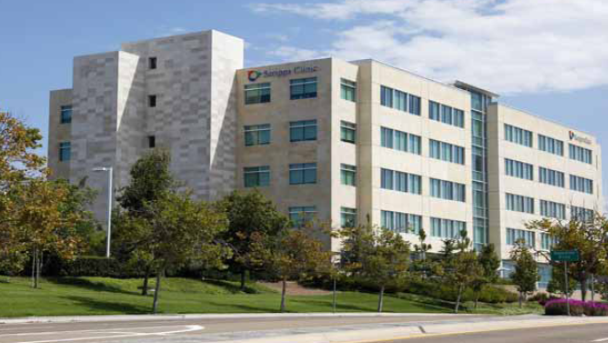
Kilroy Medical Office Portfolio Class A Medical Office Buildings
Property Details
Location San Diego, CA
Property Type Medical Office
Strategy Core
Leasable Area 250,000 sf
Occupancy 100%
Investment Details
Acquisition Date January 2012
Historical Cost $147.5 million
Market Value $147.5 million
Highlights / Objectives
Capitalize on rapid growth of healthcare industry
Stable cash flow with no near-term rollover and annual 3% rent increases
LEED certification process for both buildings in the portfolio
Investment Description
Newer product servicing exceptional demographics with strong age and population growth forecasts, which will continue to increase demand for healthcare providers
100% leased to two investment-grade credit tenants on triple net leases through 2027 and 2031
Market value and leverage as of January 31, 2012

Slide 137
The Real Estate Investable Universe 2012-13 Institutional Universe grew 6.8%, Driven by North America and Asia-Pacific Appreciation
Public Real Estate US$ 2.7 trillion
Institutional Public & Private US$7.4 trillion
Total Commercial Real Estate US$ 37.9 trillion
Source: LaSalle Investment Management As of 3Q 2012

Slide 138
Real Estate: Third Largest Asset Class Yet Only 20% of Real Estate Held by Institutional Investors
Sovereign Debt
Institutional Invested
Portion
Financial and
Corporate Debt
Source: Bank of International Settlements, World Federation of Exchanges, LaSalle Investment Management. Note that equity and debt outstanding includes REITs and real estate loans, respectively, resulting in some double-counting. Debt estimates as of June 2012. All other estimates as of 3Q 2012.

Slide 139
Global Real Estate Universe by Region, 2012-2013 Asia-Pacific Grows to 31.3% of Institutional Universe, Up From 30.5%
Listed Real Estate
Total = $2.7 trillion
Institutional Real Estate
Total = $7.4 trillion
Source: LaSalle Investment Management As of 3Q 2012
Note: The Listed Real Estate Universe includes all publicly listed property companies, primarily REITs and REOCs. Vertically integrated development companies that hold real estate are included in emerging markets, but homebuilders are excluded. The Institutional Real Estate Universe includes all institutional investor-owned property, public and private.

Slide 140
The Multi-Speed Global Economy
Low-low-low advanced and slower growing emerging economics
Developing World
Higher Inflation
High Growth and Urbanization
Rising Interest Rates
Developed World
Low Interest Rates
Low Inflation
Low Growth
Source: Global Insight Forecast as of 15 January 2013

Slide 141
Property Capital Market Cycles Differ by Market Canada Above Pre-Recession Level; UK Furthest Below Peak
Canada
Capital Value Change - Peak to Current
US
Japan
UK
Canada
Australia
US
-17.5% -21.6% -32.5% 8.5% -9.0%
UK
Source: IPD, NCREIF (US) Quarterly data Japan to 2Q 2012, all other markets through 4Q 2012
Note: IPD’s quarterly returns for Australia, Canada, and Japan are presented only on a rolling annual basis; the quarter-over-quarter series has been estimated
Series are adjusted to remove the impact of capital expenditures

Slide 142
Forecast Earnings Growth – Wide Variation LaSalle’s forecast earnings growth for 2013 – 2016
Global Real Estate Securities FFO Change
Source: LaSalle Investment Management (Securities), UBS Global Investors Index. Projections as at December 31, 2012.

Slide 143
Cross Border Investment – Rationale and Challenges
Rationale
Challenges
Larger Investment Universe
Finding Reliable Local Partners
Greater Variety of Potential Risk-Return Strategies
Low Market Transparency in Many Emerging Markets
Diversification
Limited Regional and Cross-Border Benchmarks
Availability of Tax-Efficient Structures
Currency and Political Risk
More Opportunities to Out-perform Domestic Market
Tax Drag and Capital Controls in Some Markets
Access to Emerging Market Growth
Greater Global Interconnectedness Erodes Diversification Benefits

Slide 144
Real Estate Transparency Index 2012 Back on Track – Significant Improvements Since 2010
Highly Transparent
Transparent
Semi-Transparent
Low Transparency
Opaque
Source: Jones Lang LaSalle Global Real Estate Transparency Index 2010

Slide 145
Wrap Up
Questions and Answers
Michael G. Trotsky, CFA
PRIM Executive Director
Chief Investment Officer
Steven Grossman, Treasurer and Receiver General, Chair
Michael G. Trotsky, CFA, Executive Director and Chief Investment Officer

Slide 146
Appendix
The PRIT Fund
Steven Grossman, Treasurer and Receiver General, Chair
Michael G. Trotsky, CFA, Executive Director and Chief Investment Officer

Slide 147
Global Equity Portfolio
$24.2 billion in the Global Equity Portfolio
Active Global Equity Portfolios: 35.3% of the PRIT Core Fund (10 Portfolios)
Passive Global Equity Portfolios: 64.7% of the PRIT Core Fund (4 Portfolios)
Asset Allocation as of 3/31/2013
Current Global Equity Portfolio: 45.1% of the PRIT Core Fund
Long-term Global Equity Portfolio Target: 43.0% of the PRIT Core Fund
11 Managers, 14 Portfolios, 3 Sub-Asset Classes: Domestic Equity, International Equity, and Emerging Markets Equity
Global Equity Benchmark: Currently, 35% S&P 500, 9% Russell 2500, 40% Custom MSCI World ex-US Net Dividends Investable Market Index (IMI), 16% Custom MSCI EM Net Dividends IMI
Domestic Equity
$10.9 Billion in Domestic Equity, 20.3% of PRIT Core Fund
Active Portfolios: 15.4% of Domestic Equity (2 Portfolios)
Passive Portfolios: 84.6% of Domestic Equity (2 Portfolios)
U.S. Large Cap - $8.5 billion in one passive and two “enhanced” passive S&P 500 portfolios managed by State Street Global Advisors (SSgA), INTECH, and PIMCO, respectively
U.S. Small Cap - $2.4 billion is invested with SSgA in a Russell 2500 index fund
Domestic Equity Benchmark: Currently, 80% S&P 500, 20% Russell 2500

Slide 148
International and Emerging Markets Equity Portfolios
International Equity
$9.5 billion in International Equity, 17.9% of the PRIT Core Fund.
Active Portfolios: 51.8% of International Equity (3 Portfolios).
Passive Portfolios: 48.2% of International Equity (1 Portfolio).
$4.6 billion is invested in a MSCI World Ex-US IMI Index Net Dividends index fund managed by SSgA.
$4.9 billion is invested in three active EAFE portfolios managed by: Baillie Gifford, Marathon Asset Management, and Mondrian.
International Equity Benchmark: Custom MSCI World ex-US Net Dividends IMI.
Emerging Markets Equity
$3.7 billion in Emerging Markets Equity, 6.9% of total PRIT Core Fund.
Invest in emerging equity markets of newly industrializing countries in Asia, Latin America, Southern/Eastern Europe, and Africa.
Active Portfolios: 51.0% of Emerging Markets Equity (5 Portfolios).
Passive Portfolios: 49.0% of Emerging Markets Equity (1 Portfolio).
$1.8 billion invested in an index fund managed by SSgA.
$1.7 billion invested in three active Emerging Markets Equity portfolios managed by: Ashmore-EMM, GMO (Grantham, Mayo, Van Otterloo), T. Rowe Price,
$234 million invested in two active small cap portfolios managed by Acadian and Wasatch.
Emerging Markets Equity Benchmark: Custom MSCI Emerging Markets Net Dividends IMI.

Slide 149
Total Global Equity Gross of Fees Performance as of March 31, 2013
Currently 20.3% Domestic Equity; 17.9% International Equity; 6.9% Emerging Markets Equity
Benchmark: MSCI All Country World Index (ACWI) through 10/30/11, 35% S&P 500/8% Russell 2500/42% Custom MSCI World Ex-US Net Divs. IMI/15% Custom MSCI EM IMI Net Divs. through 4/30/2012, currently 35% S&P 500, 9% Russell 2500, 40% Custom MSCI World Ex-US Net Dividends Investable Markets Index (IMI), and 16% Custom MSCI EM IMI Net Dividends.

Slide 150
PRIT Domestic Equity Gross of Fees Performance as of March 31, 2013
Benchmark: Dow Jones Wilshire 5000 thru 4/30/08; Russell 3000 thru 6/30/09; 78% Russell 3000/22% 3 Month Libor +3% thru 12/31/09, Russell 3000 thru 10/31/11, currently 80% S&P 500/20% Russell 2500.

Slide 151
PRIT International Equity Gross of Fees Performance as of March 31, 2013
Benchmark: MSCI EAFE Net Divs thru 9/30/07; MSCI EAFE Net Divs Provisional Std thru 5/31/08; MSCI EAFE Net Divs Std thru 12/31/09, currently Custom MSCI World Ex-US IMI Net Dividends customized to exclude legislatively prohibited tobacco, Sudan and, Iran securities.

Slide 152
PRIT Emerging Markets Equity Gross of Fees Performance as of March 31, 2013
Benchmark: MSCI EMF through 6/30/2004; MSCI Emerging Markets Net Dividends through 9/30/2007; MSCI Emerging Markets Net Dividends Provisional Standard Index through 5/31/2008; MSCI Emerging Markets Net Dividends Standard Index through 4/30/2010; MSCI Emerging Markets IMI Net Dividends through 12/31/2010; currently Custom MSCI Emerging Markets IMI Net Dividends, customized to exclude legislatively prohibited tobacco, Sudan and Iran securities.

Slide 153
Core Fixed Income Portfolio
$6.9 billion in the Core Fixed Income Portfolio (formerly Fixed Income).
Active Portfolios: 53.5% of Core Fixed Income.
Passive Portfolios: 46.5% of Core Fixed Income.
6 Managers, 8 Portfolios.
Asset Allocation as of 3/31/2013:
Current Core Fixed Income Portfolio: 12.9% of the PRIT Core Fund.
Long-term Core Fixed Income Target: 13.0% of the PRIT Core Fund.
$5.1 billion is invested in Core portfolios managed by Blackrock (Passive), Loomis Sayles, and PIMCO.
$537 million is invested in a Passive U.S. TIPS portfolio managed by Blackrock.
$1.1 billion is invested in and Inflation-Linked Bonds (“ILBs”) portfolio managed by Blackrock.
$245 million invested in three Economically Targeted Investment (“ETI”) portfolios managed by Access Capital, Community Capital Management, and AFL-CIO Housing Investment.
Core Fixed Income Benchmark: 77% Barclays Capital (BC) Aggregate (core bonds); 8% BC US TIPS; 15% BC ILB US$ Hedged.

Slide 154
PRIT Core Fixed Income Gross of Fees Performance as of March 31, 2013

Slide 155
Value-Added Fixed Income Portfolio
$4.4 billion in the Value-Added Fixed Income Portfolio (formerly High Yield Debt).
Active Portfolios: 100.0% of Value-Added Fixed Income.
Asset Allocation as of 3/31/13:
Current Value-Added Fixed Income Portfolio: 8.3% of the PRIT Core Fund.
Long-term Value-Added Fixed Income Target: 10.0% of the PRIT Core Fund.
21 managers in 5 sub-portfolios.
$854 is managed in three high yield portfolios by: Fidelity, Loomis, Sayles & Co, and Shenkman Capital Management.
$797 million is managed in two emerging market debt (US Dollar denominated) portfolios by: Ashmore and PIMCO.
$945 million invested in three emerging markets local currency portfolios by: Investec, Pictet, and Stone Harbor.
$540 million is invested in senior bank loans by: Eaton Vance and ING.
$1.3 billion is invested in distressed debt limited partnerships managed by: Angelo Gordon & Co., Avenue Capital Group,, Centerbridge Special Credit Partners, Crescent Capital Group, GSO Capital Opportunities, H.I.G. Capital Partners, Oaktree Capital Management, Providence TMT Special Situations, Summit Partners Subordinated Debt Fund, TCW Asset Management, Wayzata Investment Partners.
Value-Added Fixed Income Benchmark: Currently, 23.55% ML Master II HY Constrained Index/10.63% S&P LSTA Leveraged Loan Index/16.61% JPM EMBI Global/20.36% JPM GBI-EM Global Diversified/28.85% Altman Index.

Slide 156
PRIT Value-Added Fixed Income Gross of Fees Performance as of March 31, 2013
Benchmark: CSFB thru 7/02; 43% ML HY Master II/43% JPM EMBI Global/14% Actual Dist. Debt thru 2/07; 60% ML Master II HY Const./40% JPM EMBI Global thru 6/30/08; 50% ML Master II HY Const./33% JPM EMBI Global/17% S&P LSTA Lev. thru 6/30/09; 58% ML Master II HY Const./25% JPM EMBI Global/17% S&P LSTA Lev. thru 12/31/09/, 24% ML HY Master II/17% S&P LSTA Lev./20% JPM EMBI Global//39% Altman Index thru 10/31/11, 21.58% ML Master II High Yield Constrained Index; 11.08% S&P LSTA Leveraged Loan Index; 24% JPM EMBI Global; 45.10% Altman Index through April 30, 2012, currently 23.55% ML Master II HY Constrained Index/10.63% S&P LSTA Leveraged Loan Index/16.61% JPM EMBI Global/20.36% JPM GBI-EM Global Diversified/28.85% Altman Index.

Slide 157
Real Estate Portfolio
$4.8 billion in the Real Estate Portfolio, 13 Managers.
9.0% of the PRIT Fund as of 3/31/2013; Current Long-term Target is 10.0%.
$3.6 billion is invested in Core portfolios managed by INVESCO, LaSalle, AEW, J.P Morgan, and TA Associates Realty. (Portfolio debt of $1 billion).
$1.4 billion million is invested in three publicly-traded Global REIT portfolios managed by Urdang, INVESCO, and European Investors, Inc. (EII).
$201 million invested in the Non-Core 2011 portfolio (Carlyle Group and Divco West).
$20.4 million invested in the Economically Targeted Investment portfolio: Canyon Johnson II, Intercontinental IV, and New Boston Urban I.
Portfolio Benchmark: 80% NCREIF Property One Qtr Lag; 20% FTSE EPRA NAREIT Developed Net.

Slide 158
PRIT Real Estate Gross of Fees Performance as of March 31, 2013
Benchmark: NCREIF through 6/30/03; 67% NCREIF/33% FTSE NAREIT ALL EQUITY REITS through 12/31/06; NCREIF + Ratio of 2% FTSE NAREIT ALL EQUITY REITS to PRIT Fund through 03/31/08; 73% NCREIF Property One Qtr. Lag/17% FTSE NAREIT ALL EQUITY REITS/7.25% NAREIT Global REIT/2.75% NAREIT Intl REIT through 06/30/09; 82% NCREIF Property One Qtr. Lag/9% FTSE NAREIT ALL EQUITY REITS/9% FTSE EPRA NAREIT Developed Ex US REIT through 7/31/09; 80% NCREIF Property One Qtr. Lag/10% FTSE NAREIT ALL EQUITY REITS/10% FTSE EPRA NAREIT Developed Ex US REIT through 4/30/2012; currently 80% NCREIF PROPERTY ONE QTR LAG/20% FTSE EPRA NAREIT Developed Net Total Return

Slide 159
Timberland and Natural Resources Portfolio
$2.1 billion in Timber/Natural Resources.
3.9% of the total PRIT Fund a/o 3/31/2013; Target Allocation is 4.0%.
Forest Investment Associates manages $1.0 billion in timberland properties located in the Southeast U.S. and The Commonwealth of Pennsylvania. The Campbell Group manages $333 million in timberland properties located in the Northwestern U.S. and South Australia.
$380 million is invested in two publicly-traded Natural Resources portfolios: Jennison manages $200 million and T. Rowe Price manages $171 million.
$318 million is currently invested in Private Equity Natural Resources limited partnerships with Quantum Energy Partners, Tenaska Power Fund, and Denham.
Portfolio Benchmark: 53% NCREIF Timber; 39% Lipper Natural Resources Global Fund Index; 8% Actual Natural Resources Return for Private Equity.

Slide 160
PRIT Timberland/ Natural Resources Gross of Fees Performance as of March 31, 2013
Benchmark: NCREIF Timber Index thru 6/30/03; NCREIF Timber Index Ex-PRIM thru 6/30/08; 50% NCREIF TIMBER/42% LIPPER NATURAL RESOURCES GLOBAL FUND INDEX/8% ACTUAL NATURAL RESOURCES-PRIVATE thru 10/31/11; currently, 53% NCREIF TIMBER/39% LIPPER NATURAL RESOURCES GLOBAL FUND INDEX/8% ACTUAL NATURAL RESOURCES-PRIVATE

Slide 161
Hedge Funds Portfolio
The goal of the Hedge Fund component is to provide diversification from core assets (stocks and bonds) and returns between stocks and bonds over time. The expectation over a three- to five-year period is to earn a return in excess of T-Bills + 3% and a volatility approximately half of that of the U.S. stock market.
$5.0 billion market value, 9.3% of total PRIT assets a/o 3/31/2013; Current Long-term Target is 10.0%.
1 Fund-of-Fund Manager, 1 Transition Manager, and 21 Direct Hedge Fund Managers:
PAAMCO (HFOF) currently manages $790 million; broad mandate with sole focus on emerging managers. Geographic exposure primarily U.S.
Arden HFOF Liquidation $498 million in assets being transitioned from Fund-of-Funds to Direct Hedge Funds managers.
Ivy Liquidation $12.9 million. (Ivy was terminated at the February 3, 2009 PRIM Board meeting.)
Direct Hedge Funds – currently $3.7 billion is invested in differentiated hedge fund managers that form the foundation for PRIM’s direct hedge fund program, spanning strategies, geographies, sizes and years in business.
Portfolio Benchmark: HFRI Fund of Fund Composite Index.

Slide 162
Direct Hedge Fund Investments as of February 1, 2013

Slide 163
PRIT Hedge Funds Net of Fees Performance as of March 31, 2013
Benchmark: Merrill Lynch (ML) 90 Day T-Bill + 4% thru 12/31/09, currently, HFRI Fund of Funds Composite Index
HFRI Fund of Funds Composite Index Annualized 5-Year Return as of March 31, 2013 was -0.24%

Slide 164
PRIM Private Equity Portfolio
228 active partnerships; 98 active relationships.
$6.1 billion* market value as of 3/31/2013; 11.4% actual allocation; 10% target.
Follow a disciplined bottom up selection process targeting top quartile investments. Staff is size, strategy, stage, and geographically agnostic.
Maintain consistent participation in the market assuming high quality opportunities are available.
Provide long-term performance that exceeds publicly traded U.S. stocks by 300 basis points.
Maintain diversification by size, strategy, stage, and geography.
Portfolio benchmark is actual performance of Private Equity.
*Includes $160 million in Private Equity Cash

Slide 165
PRIT Private Equity Gross of Fees Performance as of March 31, 2013

